Slide 1
College of Liberal Arts Parent Session
UNH First Year Orientation 2024

Slide 2
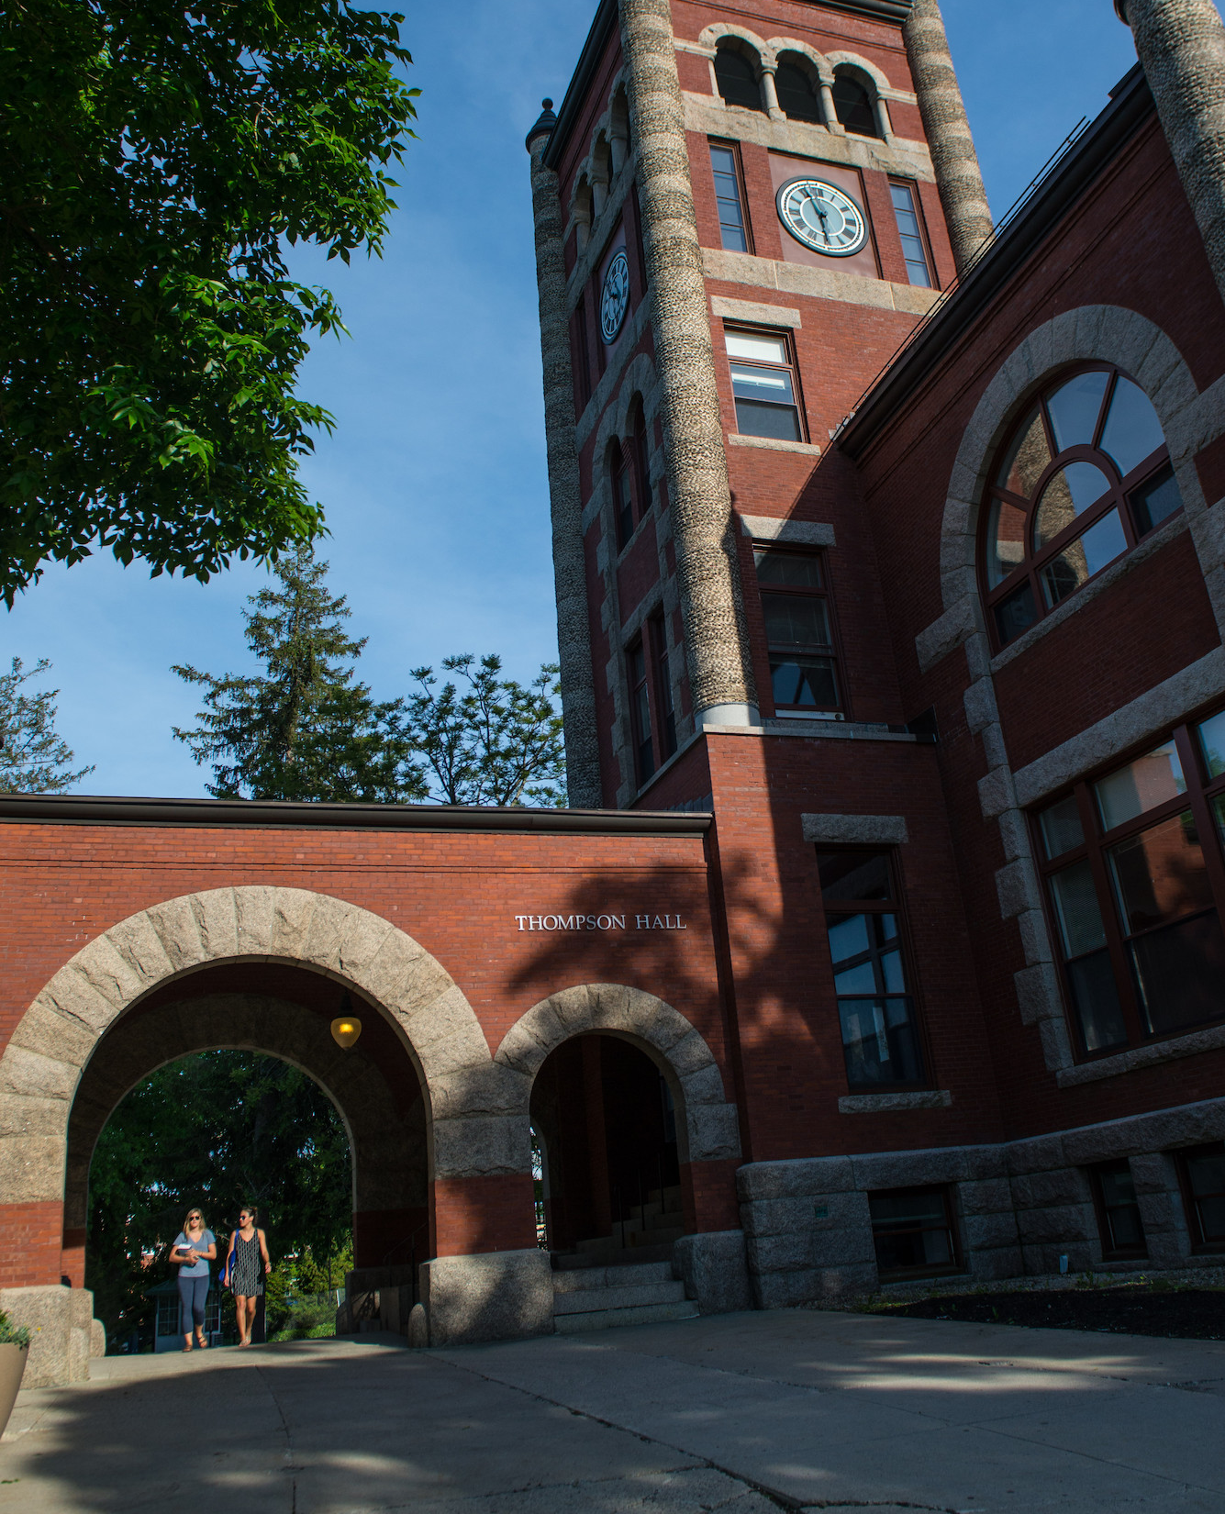
Introduction
Jenni Cook, Associate Dean College of Liberal Arts
Kevin Sousa, Director of Academic Advising and Student Success
Kelly Condon, Coordinator of First Year Students
Kelly Millar, Academic Advisor at large for COLA
Nathan Talbot, Director of the University Advising Center
Jon Constable, Director of COLA’s Career and Professional Success or CaPS

Slide 3
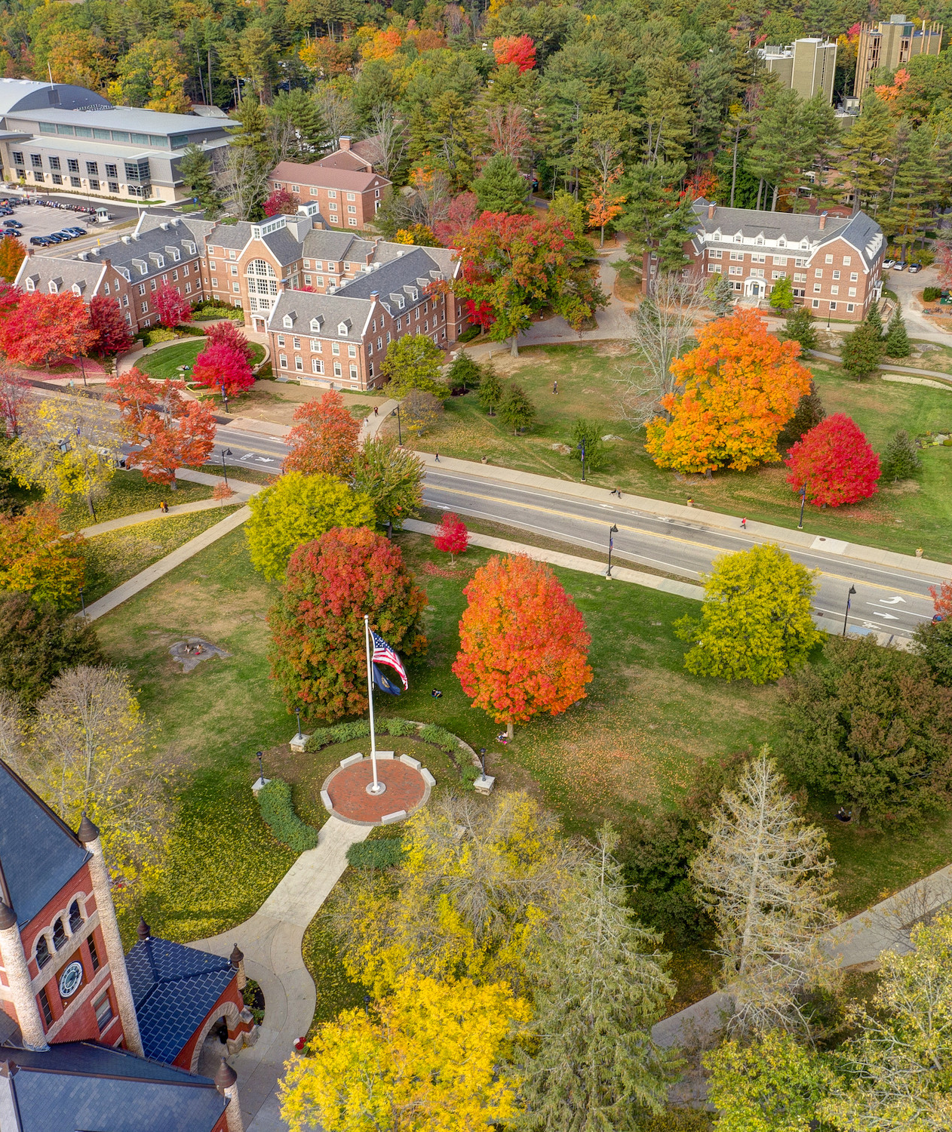
What to expect in the parent session?
Summary of what your student will be experiencing in their academic sessions during orientation including
Students will leave with their fall course schedule!
How your student will be able to check their fall schedule online
Overview of academic opportunities and student resources we will share with your student and also with you.
Q & A

Slide 4
Four pieces of advice
College is different from HS – Expect to be challenged.
Take advantage of resources.
Get involved – but not too involved.
Make smart choices!

Slide 5
How to check course schedule on Webcat Platform.

Slide 6
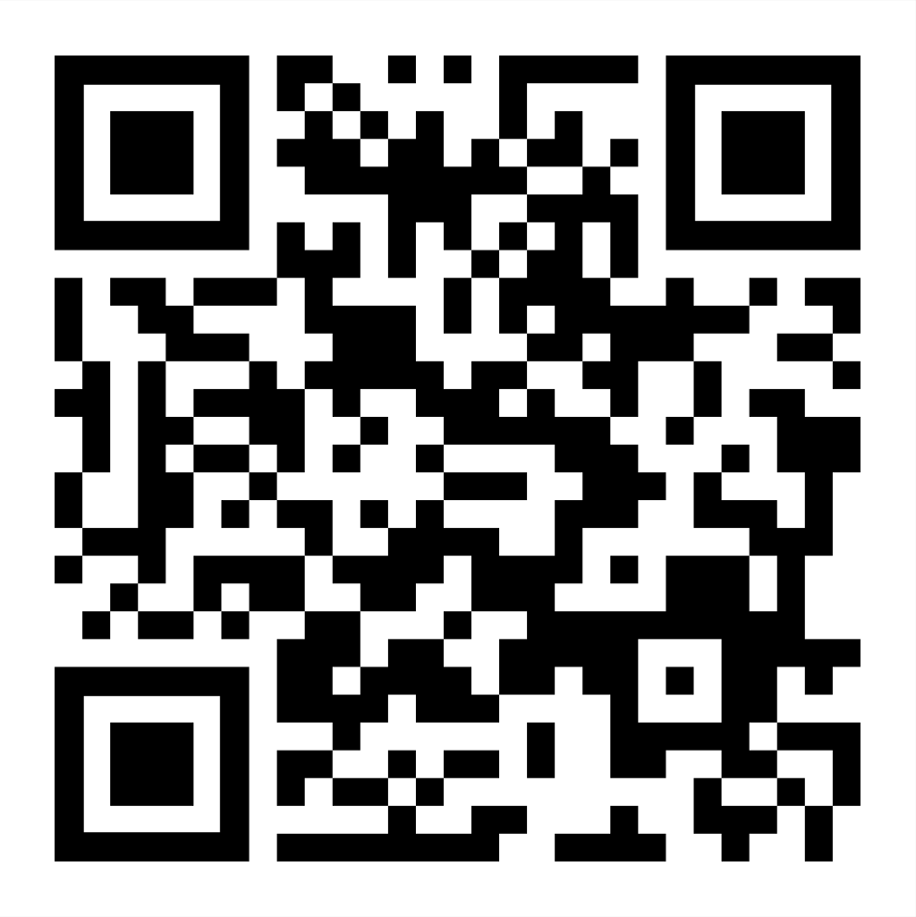
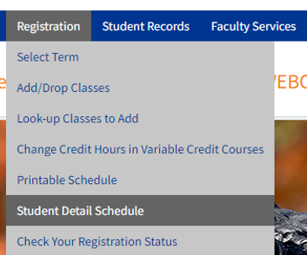
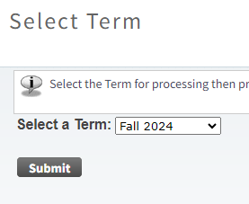
How to Find your Fall 2024 Schedule
Step 1 Step 2 Step 3
Log Into Webcat
Registration >>
Student Detail Schedule
Fall 2024 >>
Submit
Select

Slide 7
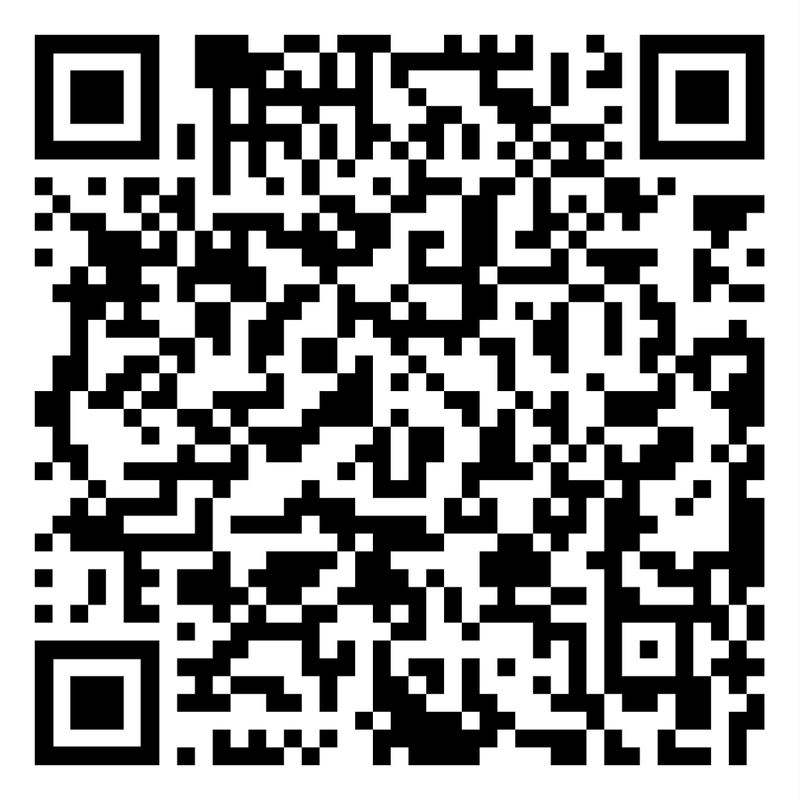
The Center for Academic Resources
Time Management
Find tools that work for you for time management
Create Daily, Weekly and Monthly Calendars
Learn how to make a to-do folder
Find study space

Slide 8
Academic Overview
https://cola.unh.edu/
COLA 401 first-year seminar for all declared and undeclared students (1 credit)
All sections have student peer mentors as well
First year students typically take 4 courses in the first semester + 1credit first year seminar.
https://www.unh.edu/new-students/orientation/first-year/academic-guides/liberal-arts
Discovery (Gen Ed) requirements
https://www.unh.edu/discovery/discovery-program-overview

Slide 9
COLA 401/401A
Extension of Orientation throughout the Fall semester- “how to college”
Introduce students to important campus resources including -CAPS, SHARPP, SAS, CFAR, and PACS
Training on important student-based platforms- My Wildcat Success, WEBCAT, DEGREEWORKS, and CANVAS
Every third week students will meet with department faculty and staff of their discipline to cover major specific matters
Community building through in-class activities
Provides an overview of academics at UNH – presentations from all five college divisions, major declaration requirements, and more (COLA 401 only)

Slide 10
Academic Overview Continued
Undergraduate Research: https://www.unh.edu/undergrad-research/programs
Study Abroad: https://www.unh.edu/global/about
SA for Parents: https://www.unh.edu/global/parents
Study Away USA: https://www.unh.edu/nse/
COLA Managed SA: https://cola.unh.edu/cola-study-abroad
Internships/jobs: https://www.unh.edu/career/
Global Racial and Social Inequality Lab or GRSIL Grant and Internship opportunities: https://cola.unh.edu/global-racial-social-inequality-lab/funding

Slide 11
Career and Professional Success (CaPS)
Important Information for Students

Slide 24
Resources
College of Liberal Arts Dean’s Office
Murkland Hall, 110
603-862-2062
Jenni.cook@unh.edu or liberal.arts@unh.edu
https://courses.unh.edu/timeroom
(course material info found here)

Slide 25
Resources Continued
Sign up for UNH alerts: https://alert.unh.edu/
Get the UNH mobile app: https://www.unh.edu/static-cpa/mobile/
Academic Calendar: https://catalog.unh.edu/undergraduate/academic-calendar/
Beauregard Center: https://www.unh.edu/beauregardcenter/ Center for Equity, Justice, and Freedom
Business Services: https://www.unh.edu/business-services/

Slide 26
Resources Continued
CfAR (Center for Academic Resources): https://www.unh.edu/cfar/
Campus safety/rides/walking escorts: https://www.unh.edu/upd/about-department/support-services-division#:~:text=UNH%20Campus%20Service%20Officers%20provide,(603)%20862%2D2328.
Another app: https://www.unh.edu/upd/Safety-apps
Computer and Software Recommendations for students:
https://td.unh.edu/TDClient/60/Portal/KB/ArticleDet?ID=1118
Degree Works: https://www.unh.edu/registrar/academic-records/degree-works-degree-evaluation
Dining: https://www.unh.edu/dining/
FERPA FAQs https://www.usnh.edu/data-services/regulated-data/family-educational-rights-privacy-act-ferpa/ferpa-faq
Financial Aid: https://www.unh.edu/financialaid/

Slide 27
Resources Continued
Health & Wellness: https://www.unh.edu/health/
Military and Veteran Services: https://www.unh.edu/veterans/
MyUSNH: (for the students-they log in to this)
Canvas Support contact info for 24/7 support within Canvas
PACS (Psychological and Counseling Services): https://www.unh.edu/pacs/
SAS (Student Accessibility Services): https://www.unh.edu/studentaccessibility/prospective-unh-students
SRRR (Student rights, rules, & responsibilities: https://catalog.unh.edu/srrr/

Slide 28
Resources Continued
Student Orgs: https://www.unh.edu/mub/student-organizations
Webcat: https://my.usnh.edu
Writing Center: https://www.unh.edu/writing/cwc
Technology Help Desk in Dimond Library 603-862-4242

Slide 29
What should your student do after orientation and before Wildcat Days/Move-in?
Regularly/once per day check your UNH email; set up to get notifications
Log in to Webcat to see your schedule
CfAR, SAS, and PACS
Booklist on courses.unh.edu
Software and Hardware recommendations:
https://td.unh.edu/TDClient/60/Portal/KB/ArticleDet?ID=1118
Parent Portal: https://www.unh.edu/main/parent-portal
Liberal.arts@unh.edu or 603-862-2062
MyUSNH: Degree Works, Canvas, MWS (Wildcat Days/move-in)

Slide 30
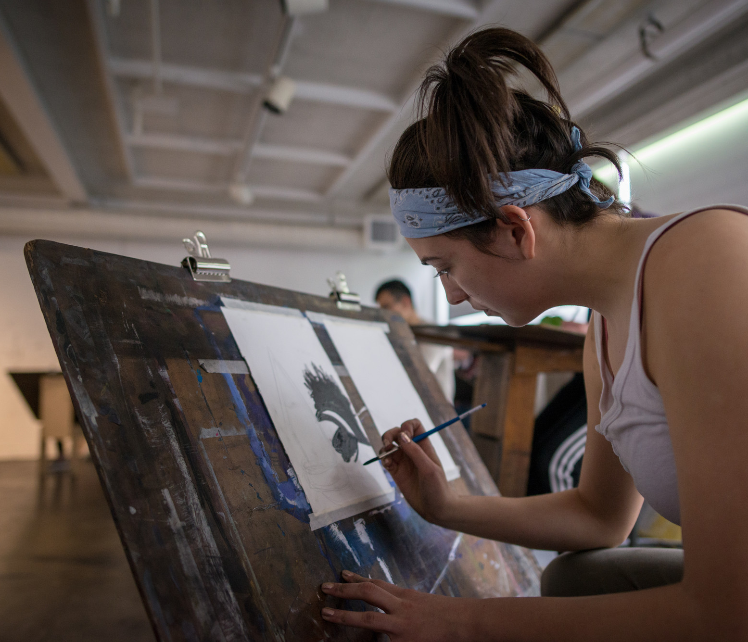
Access to these PP slides?

Slide 31
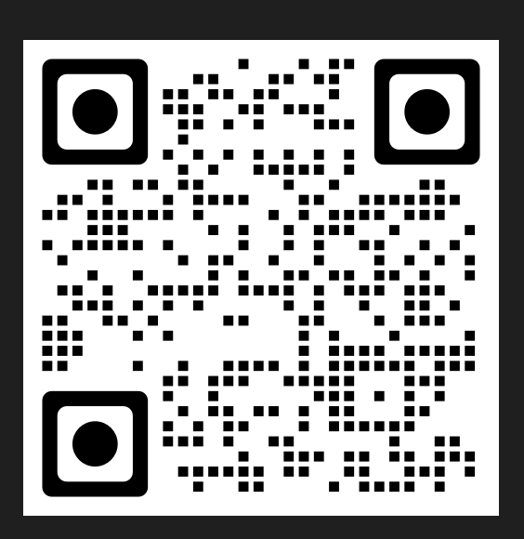
QR code to access:

Slide 32
Q & A
Questions?

Slide 33
UNH IT Help Desk
1-603-862-4242

Slide 34
Parent Portal info
https://www.unh.edu/sites/default/files/media/pdf/parent-portal-help.pdf

Slide 35
Setting up UNH email
https://td.usnh.edu/TDClient/60/Portal/KB/ArticleDet?ID=612
1-603-862-4242

Slide 37
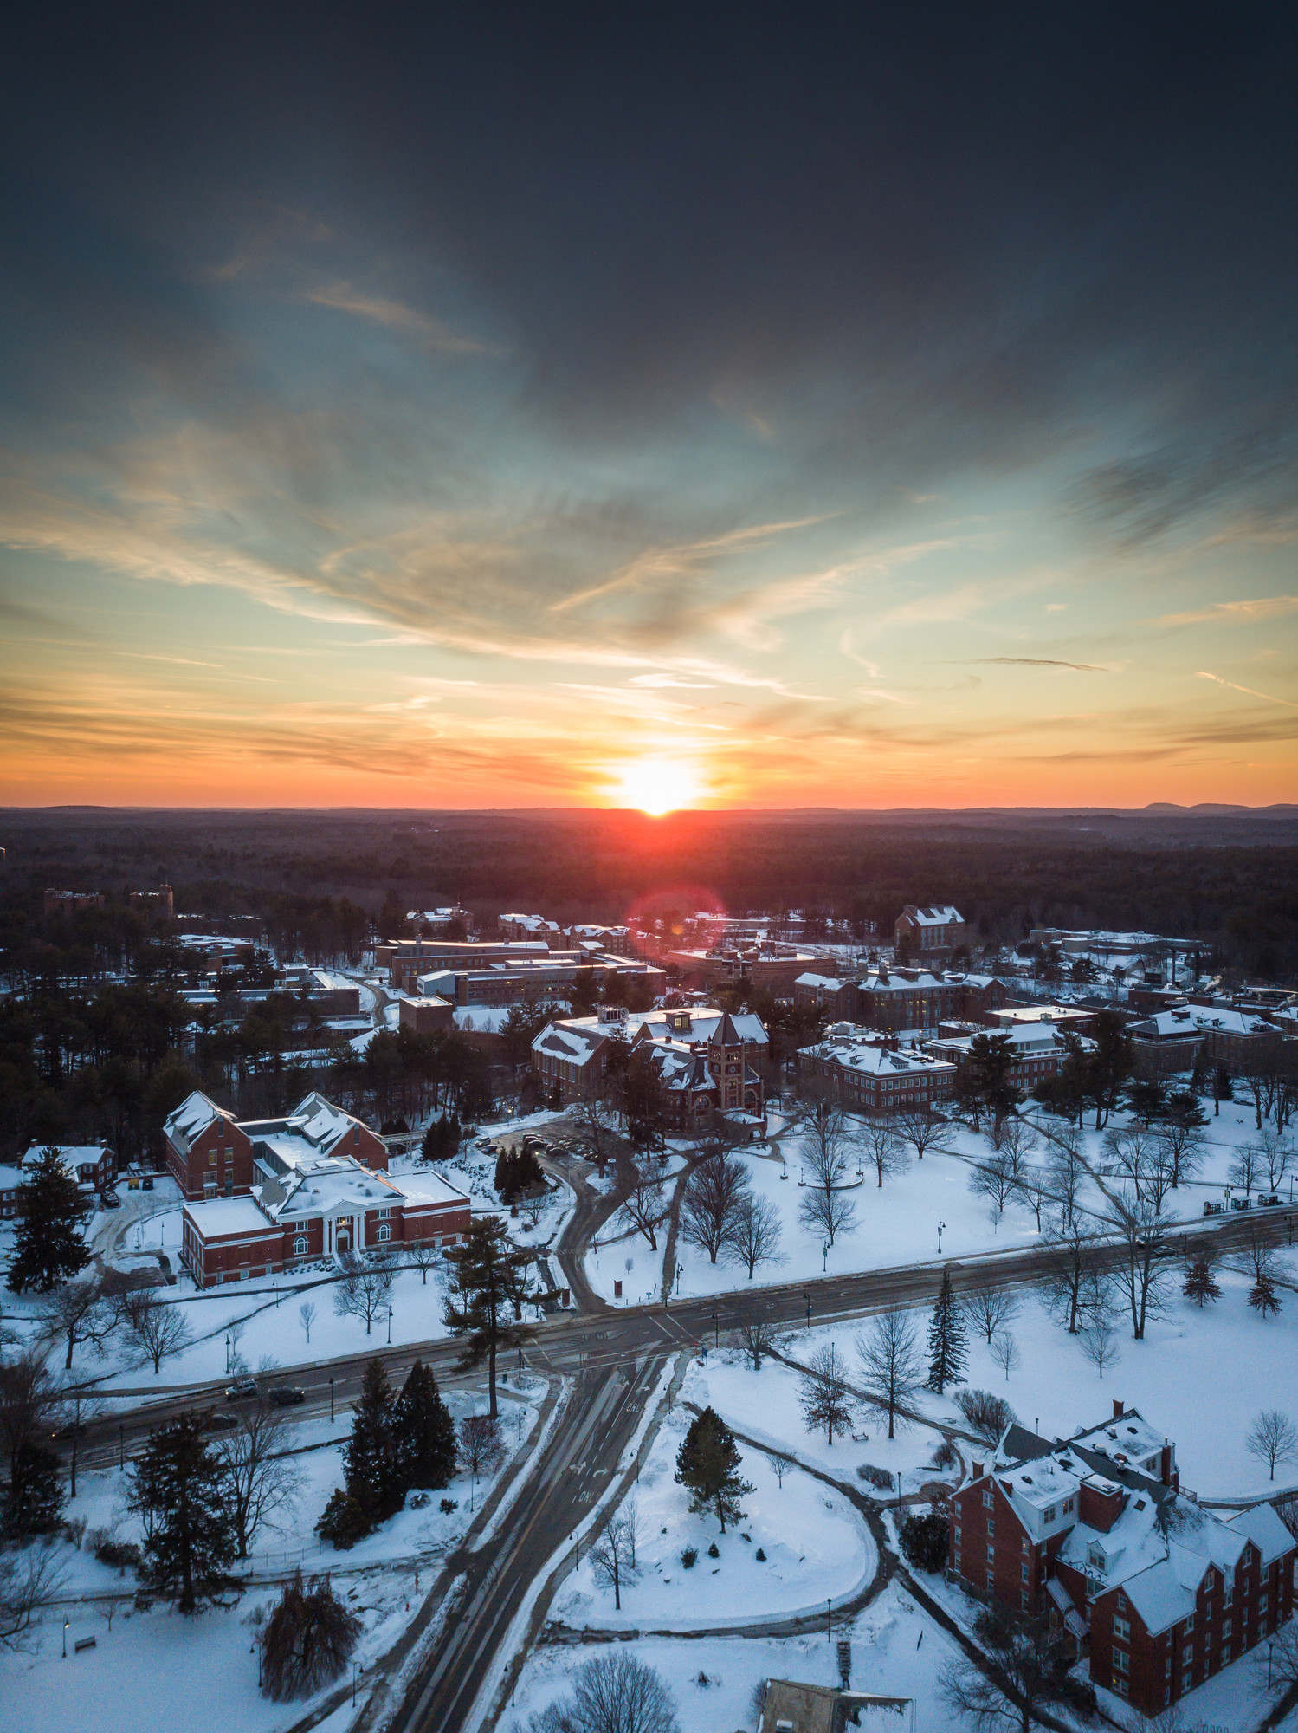
QR Code

