Slide 1
College of Liberal Arts Student Session
UNH First Year Orientation 2024

Slide 2
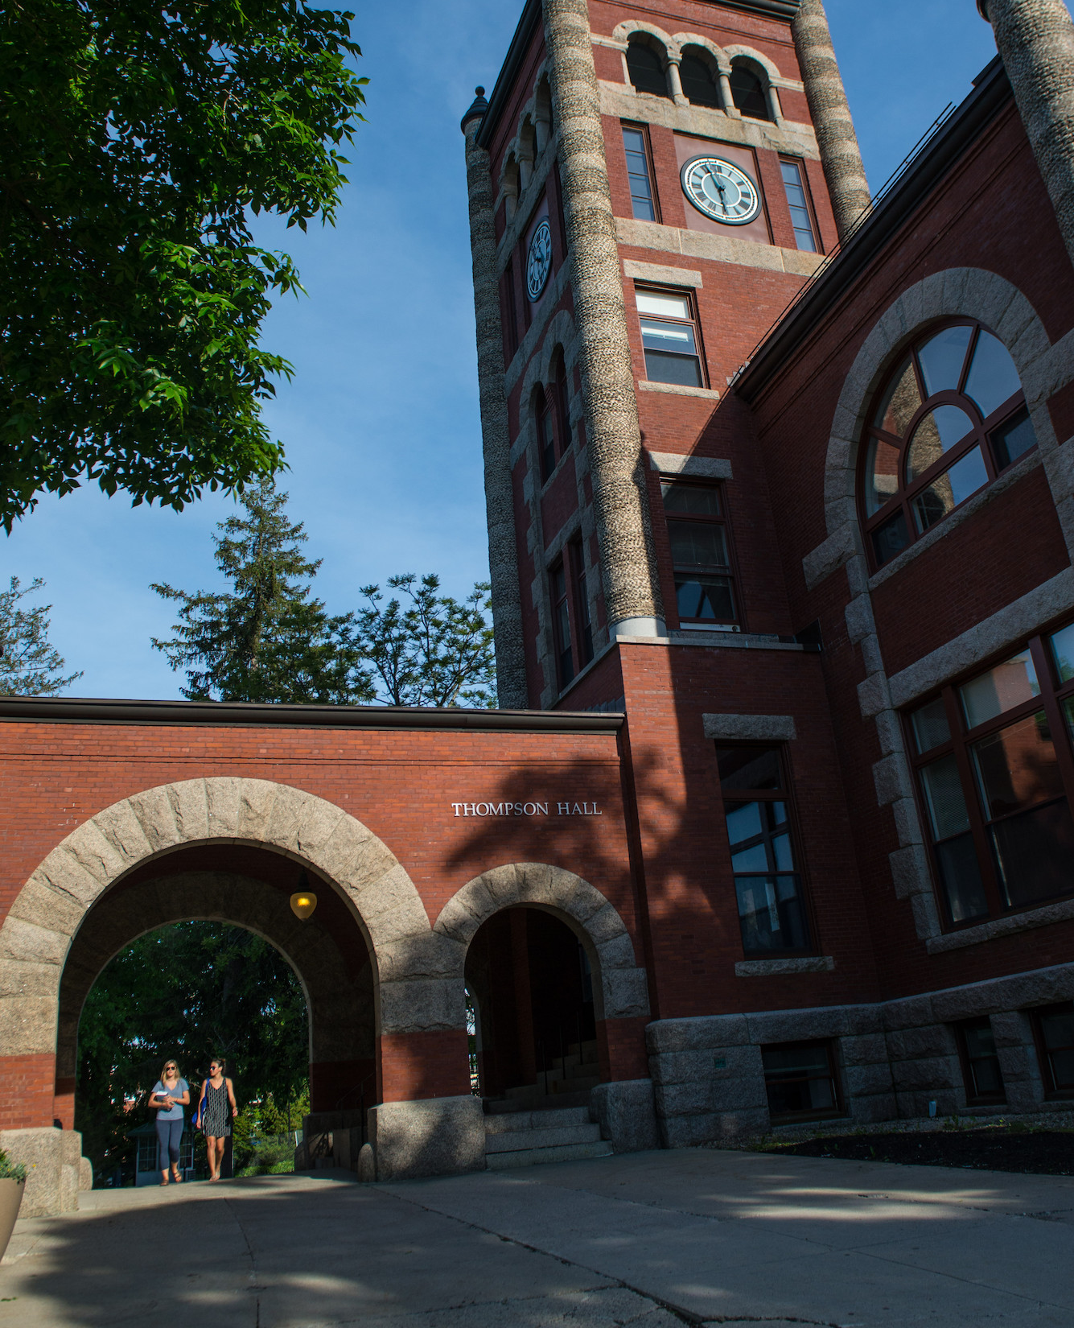
Introduction
Jenni Cook, Associate Dean College of Liberal Arts
Kevin Sousa, Director of Academic Advising and Student Success
Kelly Condon, Coordinator of First Year Students
Kelly Millar, Academic Advisor at large for COLA
Nathan Talbot, Director of the University Advising Center
Jon Constable, Director of COLA’s Career and Professional Success or CaPS

Slide 3
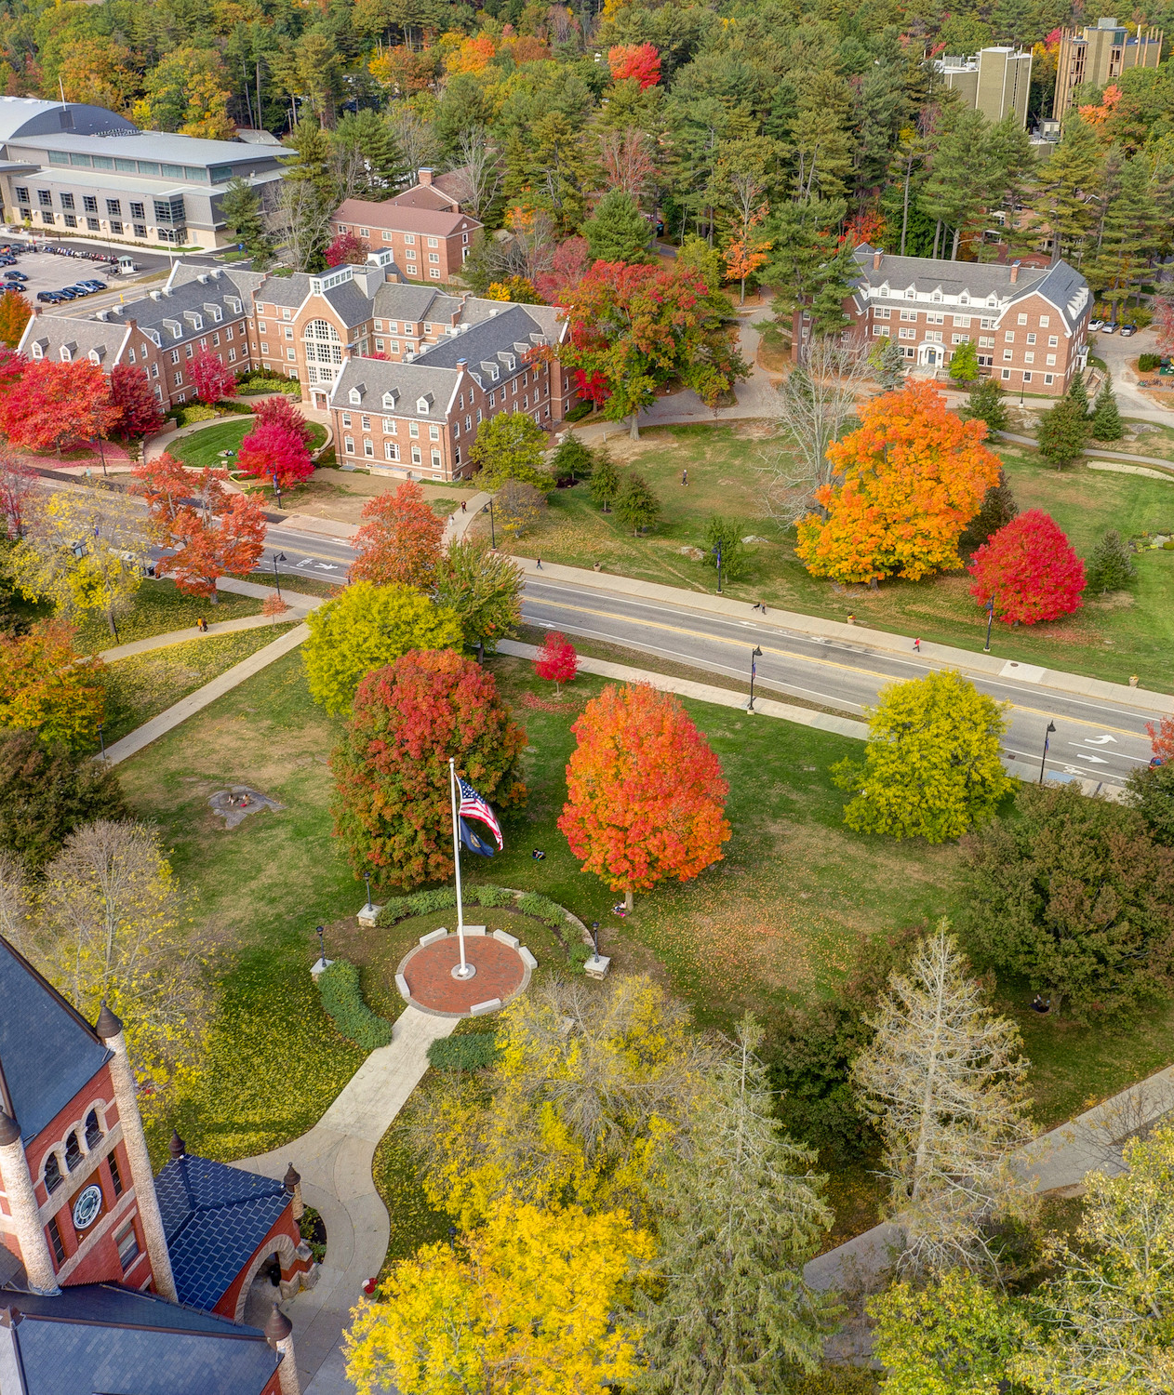
What to expect in the student session?
You will leave with your fall course schedule!
Three Overviews
Academic opportunities and student resources
First year seminar for all declared and undeclared COLA students
Career and Professional Success
You will learn how to check your fall schedule online
Q & A

Slide 4
Four pieces of advice
College is different from High School – Expect to be challenged.
Take advantage of resources.
Get involved – but not too involved.
Make smart choices!

Slide 5
Academic Overview
https://cola.unh.edu/
COLA 401 first-year seminar for all declared and undeclared students (1 credit)
All sections have student peer mentors as well
First year students typically take 4 courses in the first semester + 1credit first year seminar.
https://www.unh.edu/new-students/orientation/first-year/academic-guides/liberal-arts
Discovery (Gen Ed) requirements
https://www.unh.edu/discovery/discovery-program-overview

Slide 6
COLA 401/401A
Extension of Orientation throughout the Fall semester- “how to college”
Introduce students to important campus resources including -CAPS, SHARPP, SAS, CFAR, and PACS
Training on important student-based platforms- My Wildcat Success, WEBCAT, DEGREEWORKS, and CANVAS
Every third week students will meet with department faculty and staff of their discipline to cover major specific matters
Community building through in-class activities
Provides an overview of academics at UNH – presentations from all five college divisions, major declaration requirements, and more (COLA 401 only)

Slide 7
Academic Overview Continued
Undergraduate Research: https://www.unh.edu/undergrad-research/programs
Study Abroad: https://www.unh.edu/global/about
SA for Parents: https://www.unh.edu/global/parents
Study Away USA: https://www.unh.edu/nse/
COLA Managed SA: https://cola.unh.edu/cola-study-abroad
Internships/jobs: https://www.unh.edu/career/
Global Racial and Social Inequality Lab or GRSIL Grant and Internship opportunities: https://cola.unh.edu/global-racial-social-inequality-lab/funding

Slide 8
Career and Professional Success (CaPS)
Important Information for Students

Slide 21
Resources
College of Liberal Arts Dean’s Office
Murkland Hall, 110
603-862-2062
Jenni.cook@unh.edu or liberal.arts@unh.edu
Undeclared COLA and have an advising question?
Uac.advisors@unh.edu
https://courses.unh.edu/timeroom
(course material info found here)

Slide 22
Resources Continued
Sign up for UNH alerts: https://alert.unh.edu/
Get the UNH mobile app: https://www.unh.edu/static-cpa/mobile/
Academic Calendar: https://catalog.unh.edu/undergraduate/academic-calendar/
Beauregard Center: https://www.unh.edu/beauregardcenter/
Center for Equity, Justice, and Freedom
Business Services: https://www.unh.edu/business-services/

Slide 23
Resources Continued
CfAR (Center for Academic Resources): https://www.unh.edu/cfar/
Campus safety/rides/walking escorts: https://www.unh.edu/upd/about-department/support-services-division#:~:text=UNH%20Campus%20Service%20Officers%20provide,(603)%20862%2D2328.
Another app: https://www.unh.edu/upd/Safety-apps
Computer and Software Recommendations for students:
https://td.unh.edu/TDClient/60/Portal/KB/ArticleDet?ID=1118
Degree Works: https://www.unh.edu/registrar/academic-records/degree-works-degree-evaluation
Dining: https://www.unh.edu/dining/
FERPA FAQs https://www.usnh.edu/data-services/regulated-data/family-educational-rights-privacy-act-ferpa/ferpa-faq
Financial Aid: https://www.unh.edu/financialaid/

Slide 24
Resources Continued
Health & Wellness: https://www.unh.edu/health/
Military and Veteran Services: https://www.unh.edu/veterans/
MyUSNH: (for the students-they log in to this)
Canvas Support contact info for 24/7 support within Canvas
PACS (Psychological and Counseling Services): https://www.unh.edu/pacs/
SAS (Student Accessibility Services): https://www.unh.edu/studentaccessibility/prospective-unh-students
SRRR (Student rights, rules, & responsibilities: https://catalog.unh.edu/srrr/

Slide 25
Resources Continued
Student Orgs: https://www.unh.edu/mub/student-organizations
Webcat: https://my.usnh.edu
Writing Center: https://www.unh.edu/writing/cwc
Technology Help Desk in Dimond Library 603-862-4242

Slide 26
How to check course schedule on Webcat Platform.

Slide 27
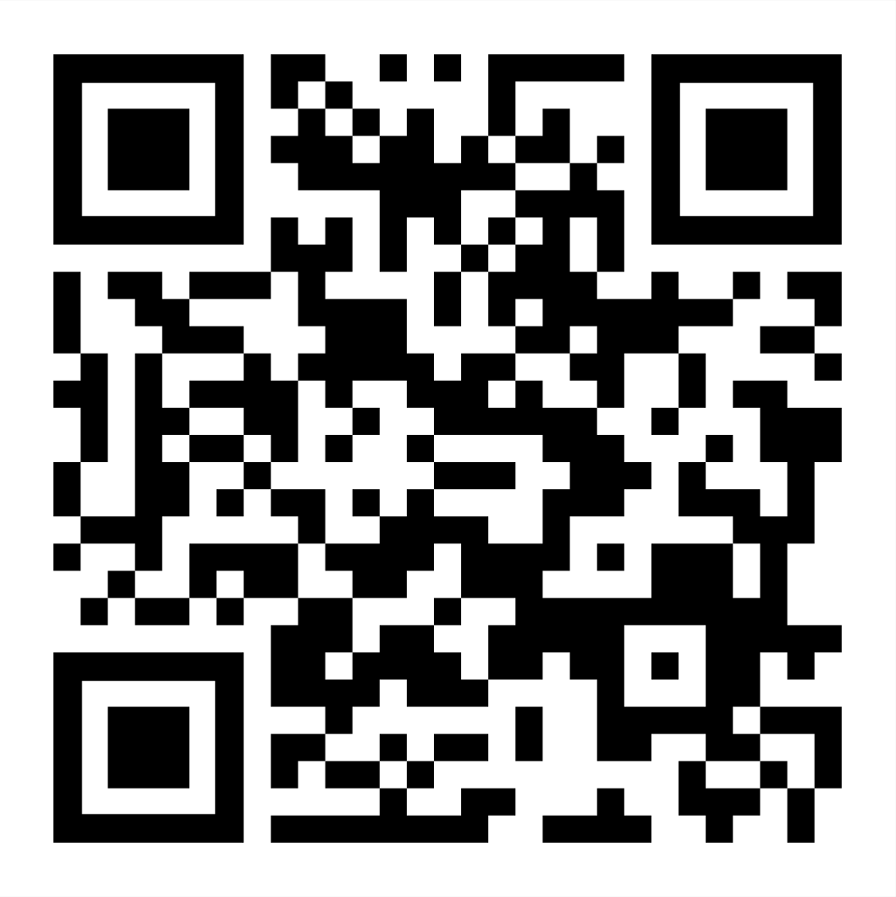
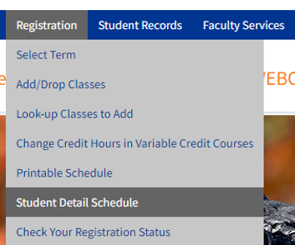
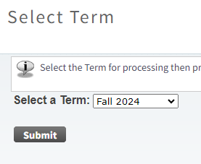
How to Find your Fall 2024 Schedule
Step 1 Step 2 Step 3
Log Into Webcat
Registration >>
Student Detail Schedule
Fall 2024 >>
Submit
Select

Slide 28
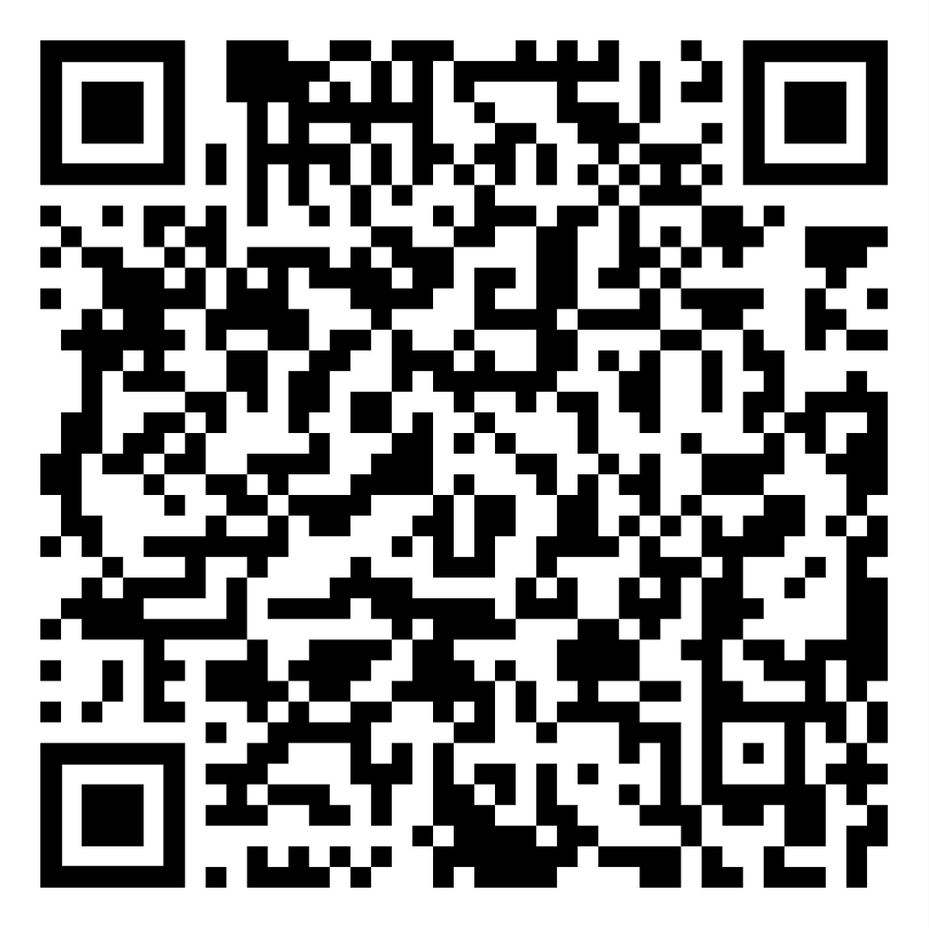
The Center for Academic Resources
Time Management
Find tools that work for you for time management
Create Daily, Weekly and Monthly Calendars
Learn how to make a to-do folder
Find study space

Slide 29
What should I do after orientation and before Wildcat Days/Move-in?
Regularly/once per day check your UNH email; set up to get notifications
Log in to Webcat to see your schedule
CfAR, SAS, and PACS
Booklist on courses.unh.edu
Software and Hardware recommendations:
https://td.unh.edu/TDClient/60/Portal/KB/ArticleDet?ID=1118
Parent Portal: https://www.unh.edu/main/parent-portal
Liberal.arts@unh.edu or 603-862-2062
MyUNH: Degree Works, Canvas, MWS (Wildcat Days/move-in)
UNH IT Help Desk: 1-603-862-4242

Slide 30
Parent Portal info
https://www.unh.edu/sites/default/files/media/
pdf/parent-portal-help.pdf

Slide 31
Setting up UNH email
https://my.unh.edu/task/durham/wildcatsmail-task
1-603-862-4242

Slide 32
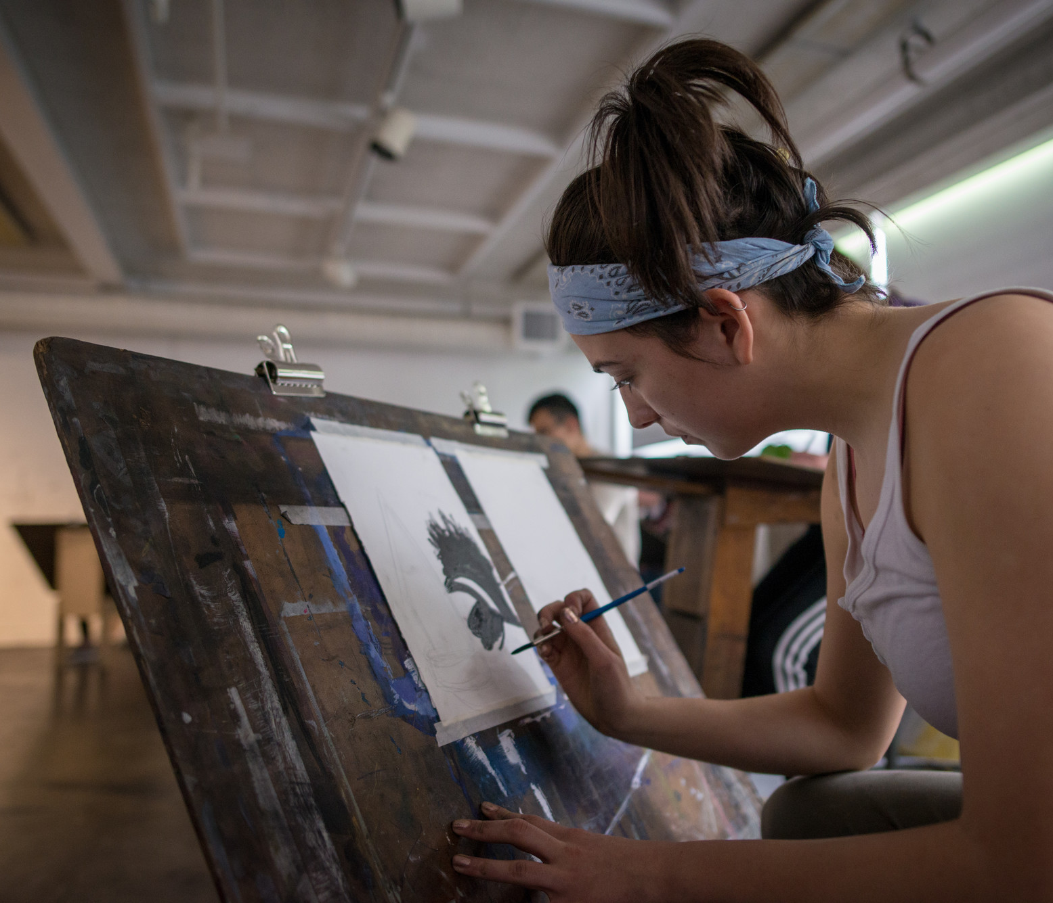
Access to these PP slides?

Slide 33
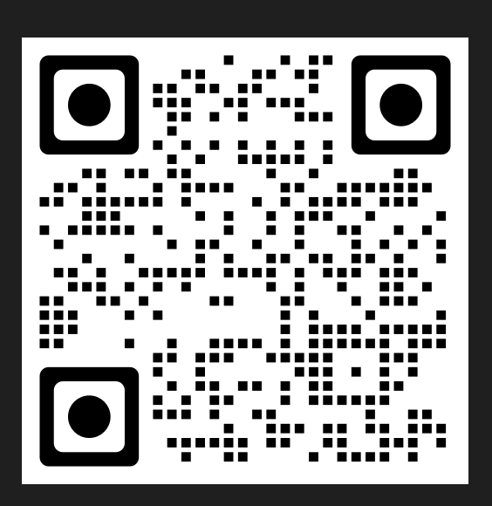
QR code to access:

Slide 35
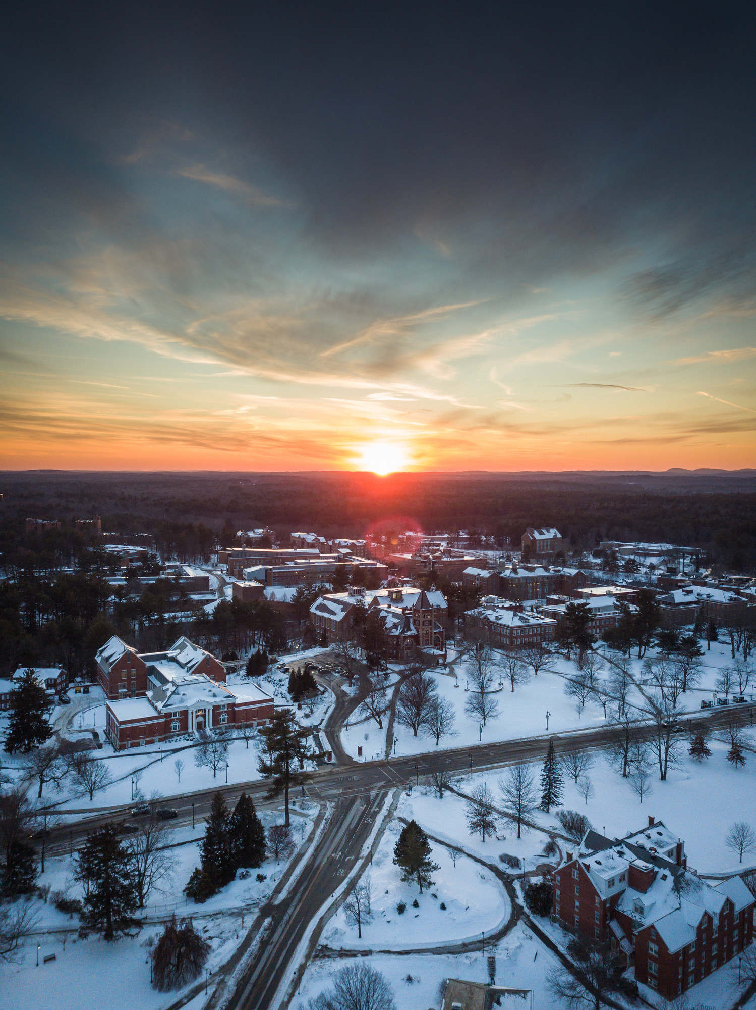
PP QR and email contact
Liberal.arts@unh.edu
Uac.advisors@unh.edu

