Slide 1
College of Liberal Arts Student Session
UNH Student Orientation 2025

Slide 2
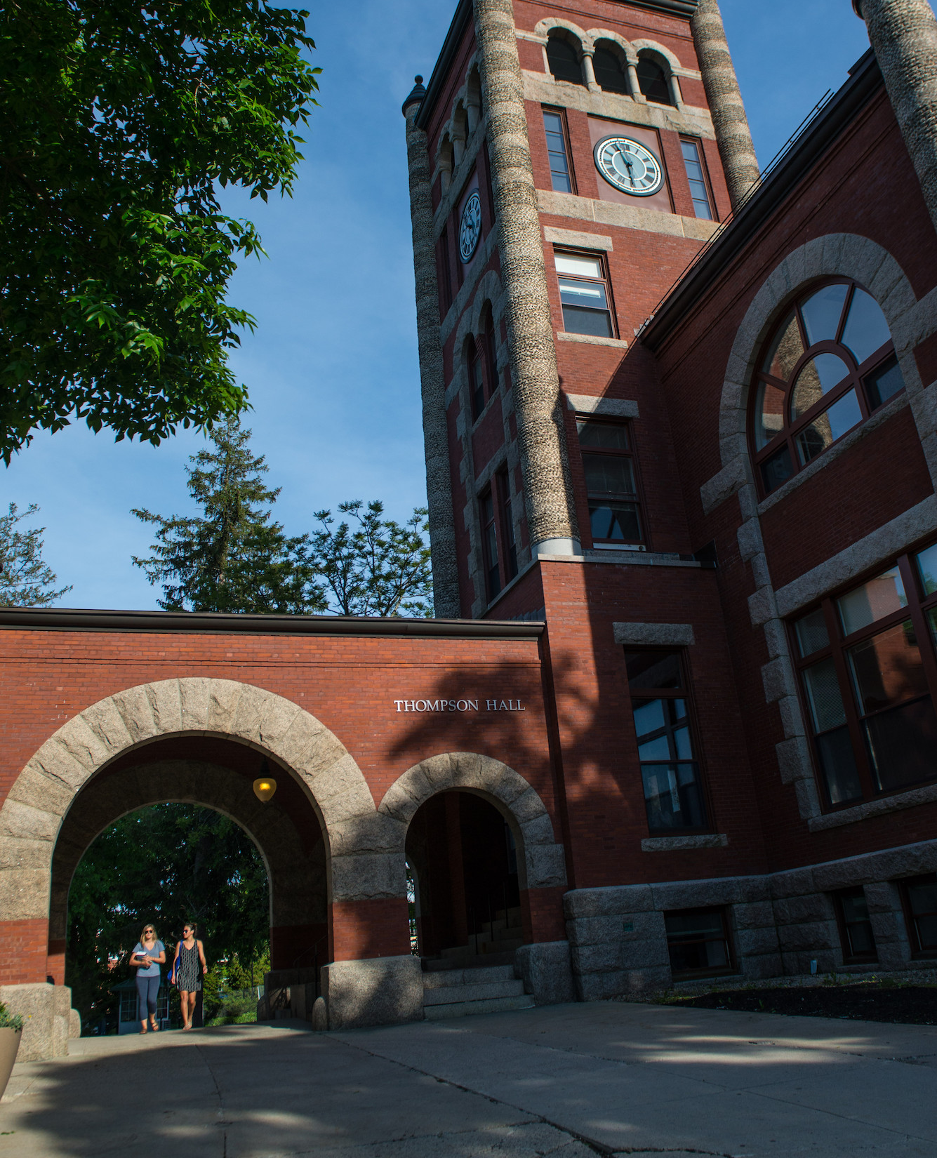
Introduction
Jenni Cook, Associate Dean
College of Liberal Arts
Nathan Talbot, Director
University Advising Center

Slide 3
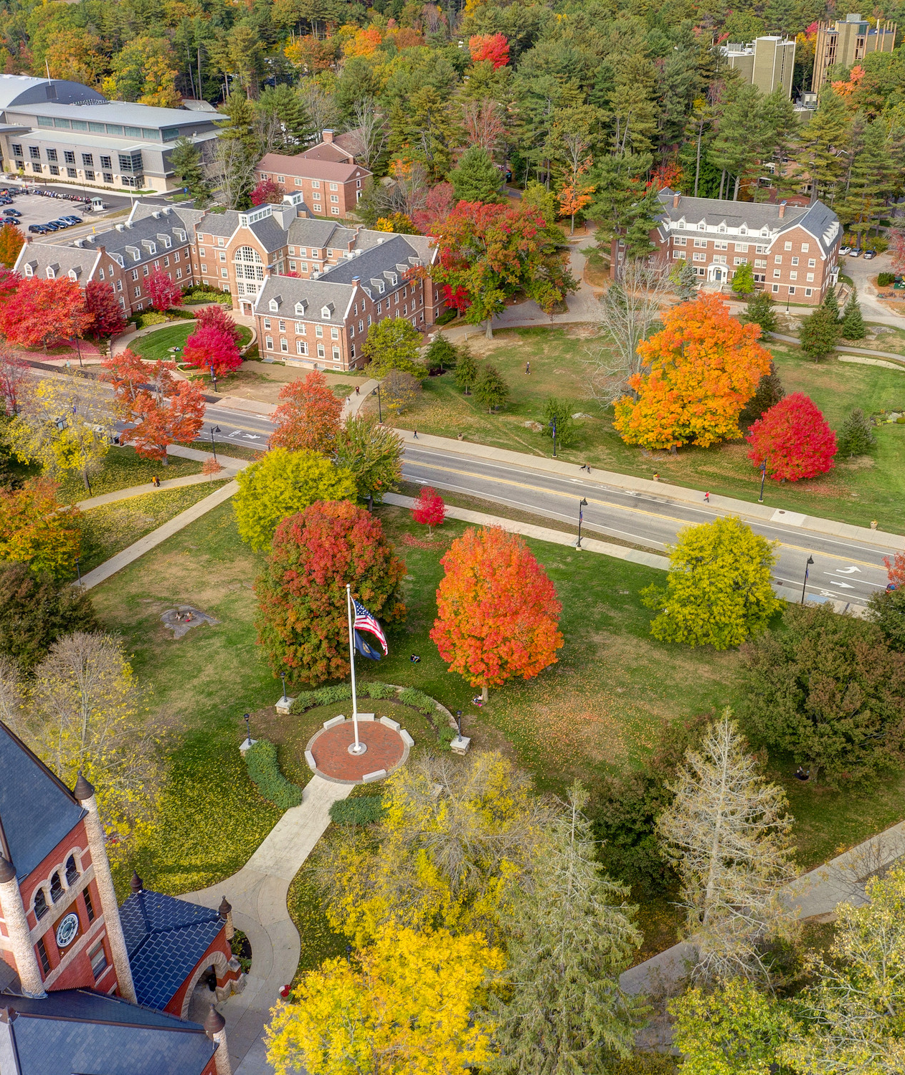
What to expect in the student session?
Review/finalize fall schedule
Three Overviews
Academic opportunities
First year seminar for all declared and undeclared COLA students
Career and Professional Success
Student Resources
Q & A

Slide 4
Four pieces of advice
College is different from High School – Expect to be challenged.
Take advantage of resources.
Get involved – but not too involved.
Make smart choices/Ask for help!

Slide 5
U-Day
Thursday, Sept. 4th, 2025
3:30-6:30 p.m.
Thompson Hall Lawn
UDay is a tradition here at UNH that brings together students, staff, faculty and Durham community members to celebrate and learn about the more than 300 student groups, campus departments, local businesses and more. It's one of the best ways to get involved!

Slide 6
Academic Overview
Undergraduate Research: https://www.unh.edu/undergrad-research/programs
Study Abroad: Education Abroad | UNH Global
THURSDAY, Sept. 4th 1-2 p.m. Study Abroad Fair in the MUB Granite State Room
SA for PSA for Parents: https://www.unh.edu/global/parents
Study Away USA: https://www.unh.edu/nse/
COLA Managed SA: https://cola.unh.edu/cola-study-abroad
Internships/jobs: https://www.unh.edu/career/
Global Racial and Social Inequality Lab | College of Liberal Arts

Slide 7
COLA 401/401A/401T
Extension of Orientation throughout the Fall semester- “how to college”
Introduce students to important campus resources including -CAPS, SHARPP, SAS, CFAR, and PACS
Training on important student-based platforms- My Wildcat Success, WEBCAT, DEGREEWORKS, and CANVAS
Every third week students will meet with department faculty and staff of their discipline to cover major specific matters if a declared major
Community building through in-class activities
If an undeclared student: Provides an overview of academics at UNH – presentations from all five college divisions, major declaration requirements, and more (COLA 401 only)

Slide 8
Campus Jobs
Opportunities
Campus units that hire student employees include:
Dining
Events & Conferences
Campus Recreation
Dimond Library
Transportation
And many more
Resources
Workday*
Student Worker Resources Hub*
Work-Study at UNH
*Internal links your student can access with their UNH credentials.

Slide 9
Internships
Opportunities
200+ shared by our Internship Coordinator last year
9000+ on Handshake
Fields include sales, marketing, mental health care, education, art and entertainment, museums, pharmaceuticals, government, etc.
Resources
On-Campus Job & Internship Fairs
Pre-Internship Advising
Internship Opportunity Fund
COLA 505 – Hired: A Boot Camp

Slide 10
Contact information and course listings
College of Liberal Arts Dean’s Office
Murkland Hall, 110
603-862-2062
Jenni.cook@unh.edu or liberal.arts@unh.edu
Undeclared COLA and have an advising question?
Uac.advisors@unh.edu

Slide 11
Resources
Sign up for UNH alerts: https://alert.unh.edu/
Get the UNH mobile app: Get the UNH Mobile App - University System of New Hampshire
Academic Calendar: https://catalog.unh.edu/undergraduate/academic-calendar/
Student Orgs: https://www.unh.edu/mub/student-organizations
Webcat: https://my.usnh.edu
Writing Center: https://www.unh.edu/writing/cwc
Technology Help Desk in Dimond Library 603-862-2525

Slide 12
Resources
CfAR (Center for Academic Resources): https://www.unh.edu/cfar/
Campus safety/rides/walking escorts: https://www.unh.edu/upd/about-department/support-services-division#:~:text=UNH%20Campus%20Service%20Officers%20provide,(603)%20862%2D2328.
Another app: https://www.unh.edu/upd/Safety-apps
Computer and Software Recommendations for students:
https://td.unh.edu/TDClient/60/Portal/KB/ArticleDet?ID=1118
Degree Works: https://www.unh.edu/registrar/academic-records/degree-works-degree-evaluation
Dining: https://www.unh.edu/dining/
FERPA FAQs https://www.usnh.edu/data-services/regulated-data/family-educational-rights-privacy-act-ferpa/ferpa-faq
Financial Aid: https://www.unh.edu/financialaid/

Slide 13
Resources Continued
Health & Wellness: https://www.unh.edu/health/
Military and Veteran Services: https://www.unh.edu/veterans/
MyUSNH: (for the students-they log in to this)
Canvas Support contact info for 24/7 support within Canvas
PACS (Psychological and Counseling Services): https://www.unh.edu/pacs/
SAS (Student Accessibility Services): https://www.unh.edu/studentaccessibility/prospective-unh-students
SRRR (Student rights, rules, & responsibilities: https://catalog.unh.edu/srrr/
Student Accounts: Student Accounts | University of New Hampshire

Slide 14
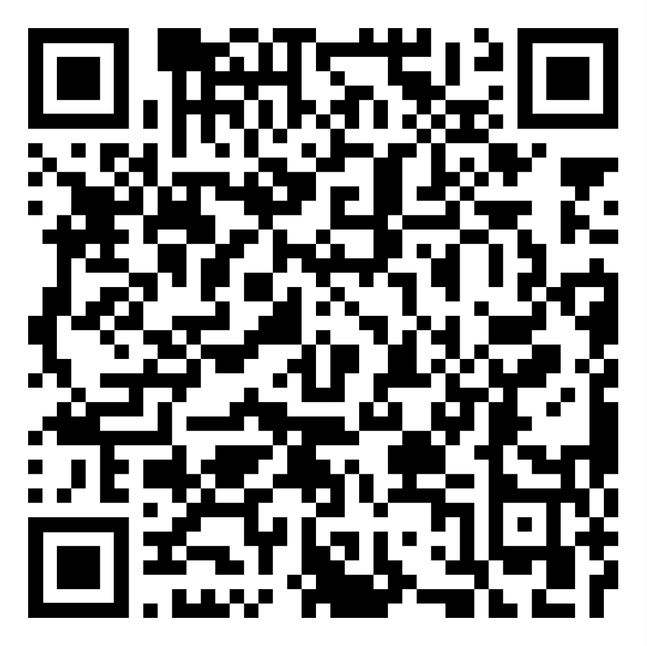
The Center for Academic Resources
Time Management
Find tools that work for you for time management
Create Daily, Weekly and Monthly Calendars
Learn how to make a to-do folder
Find study space

Slide 15
What should I do after orientation and before Wildcat Days/Move-in?
Regularly/once per day check your UNH email; set up to get notifications
Log in to Webcat to see your schedule
CfAR, SAS, and PACS
Booklist on courses.unh.edu
Software and Hardware recommendations:
https://td.unh.edu/TDClient/60/Portal/KB/ArticleDet?ID=1118
Parent Portal: https://www.unh.edu/main/parent-portal
Liberal.arts@unh.edu or 603-862-2062
MyUNH: Degree Works, Canvas, MWS (Wildcat Days/move-in)
UNH IT Help Desk: 1-603-862-2525

Slide 16
Parent Portal info
https://www.unh.edu/sites/default/files/media/
pdf/parent-portal-help.pdf

Slide 17
Setting up UNH email
https://my.unh.edu/task/durham/wildcatsmai
l-task
1-603-862-2525

Slide 18
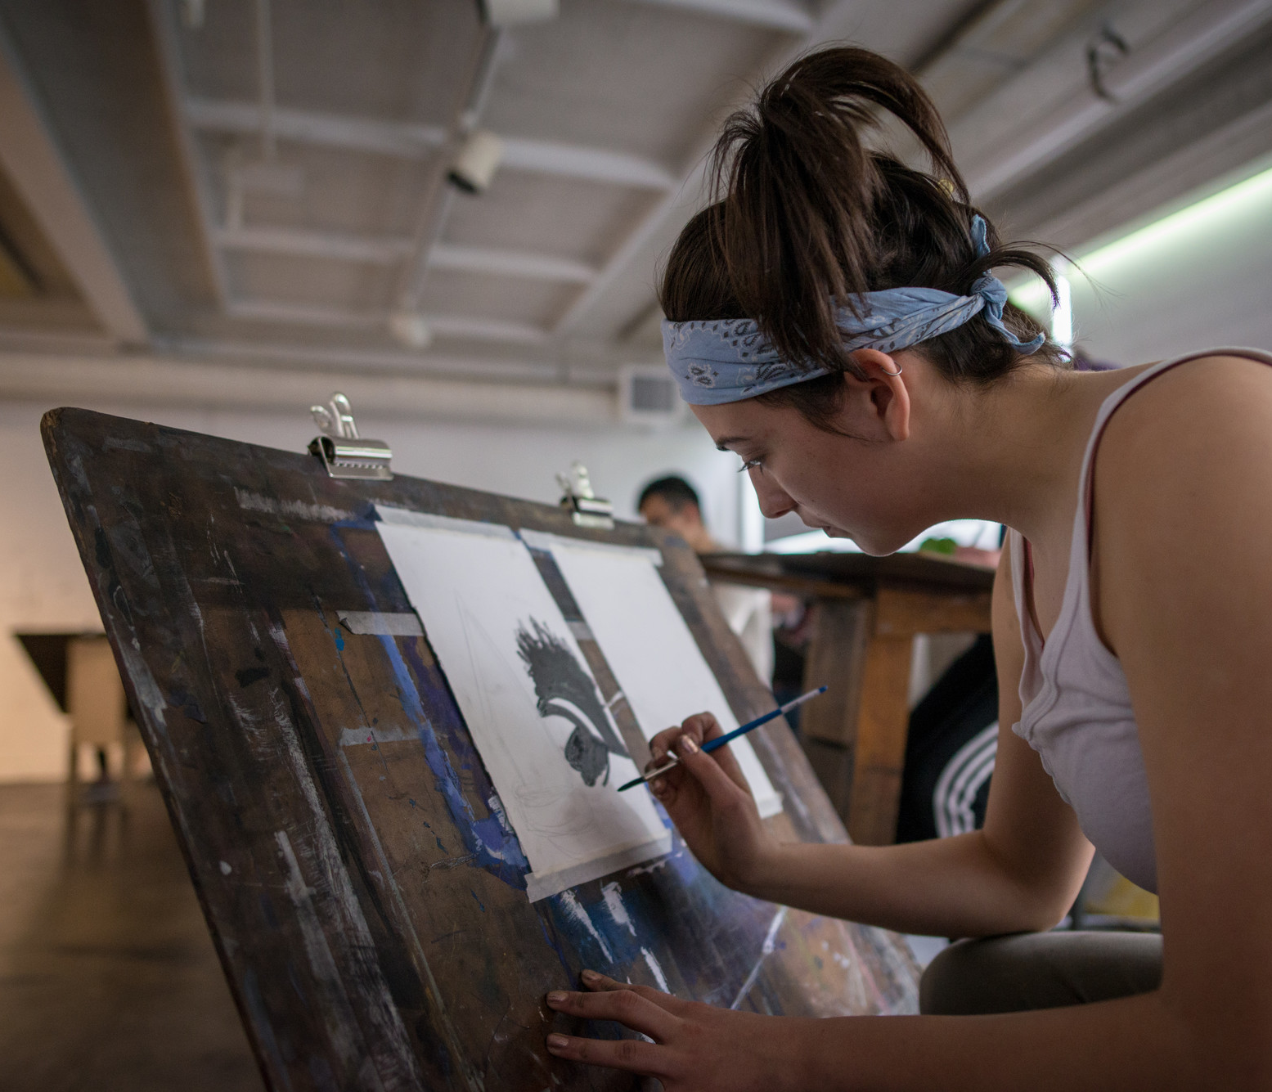
Access to these PP slides?

Slide 19
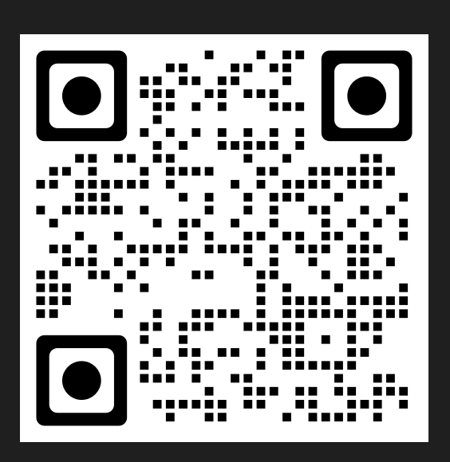
QR code to access:

Slide 21
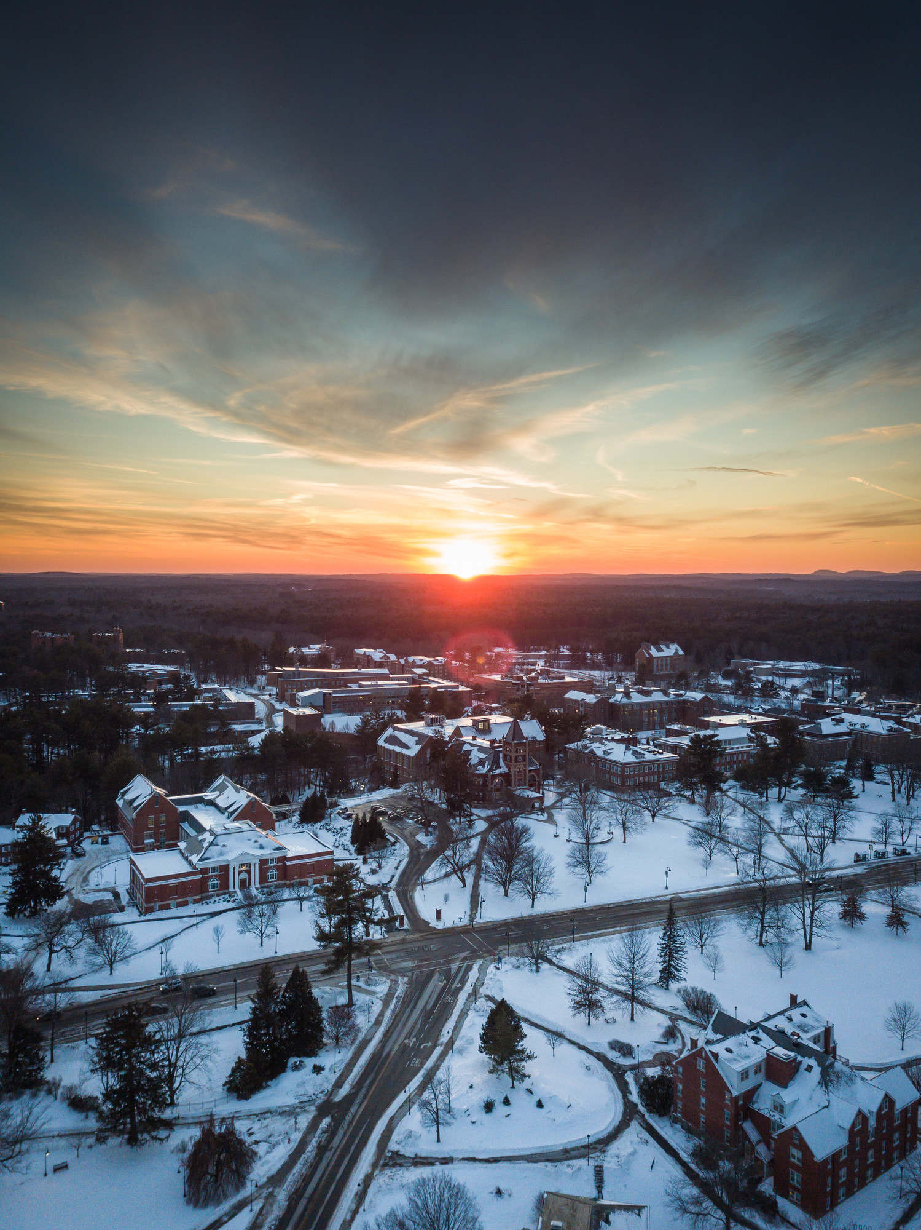
PP QR and email contact
Liberal.arts@unh.edu
Uac.advisors@unh.edu

