Slide 1
College of Liberal Arts Parent Session
UNH Orientation 2026

Slide 2
Introduction
J
Jenni Cook, Associate Dean
College of Liberal Arts
Nathan Talbot, Director
University Advising Center

Slide 3
What to expect in the parent session?
Learn what we are sharing with your student
  Review/finalize fall schedule
  Sample student 4-year academic and career pathway that demonstrates various academic, experiential and high impact opportunities that UNH offers.
  First semester seminar for all declared and undeclared COLA students
  Student Resources
Q & A

Slide 4
Sample Four-Year Pathway

Slide 5
Freshman Year
Fall
January Term
Spring
Summer
17 Credits
Declare Political Science Major
School Ski Trip
16 Credits
Declare Dual Major in Justice Studies
ACADEMIC
Meet with advisor to discuss spring courses and student opportunities to consider
Meet with study abroad advisor
Meet with advisor to discuss courses for next fall
ADVISING
HIGH-IMPACT
EXPERIENCE
WORK &
EXTRA CURRICULAR
Full-Time Job
at Home

Slide 6
Sophomore Year
Fall
January Term
Spring
Summer
4 Credits:
Discovery course: asynchronous online
ACADEMIC
16 Credits
18 Credits
Meet with advisor to discuss spring courses
Sign up for pre-internship advising
ADVISING
Meet with advisor to discuss courses for next fall
HIGH-IMPACT
EXPERIENCE
Attend UNH career & internship fair
Attend UNH career & internship fair
Apply to the Internship Opportunity Fund
Submit applications and interview for summer internship
Apply to be a RA for junior year
WORK &
EXTRA CURRICULAR
Attend Hall council meeting
Paid internship

Slide 7
Junior Year
Fall
January Term
Spring
Summer
4 Credits
Short-term study abroad: faculty-led
ACADEMIC
17 Credits
16 Credits
Meet with advisor to discuss spring courses
Meet with advisors and review degree audit for both majors to be sure on track for graduation
ADVISING
HIGH-IMPACT
EXPERIENCE
Apply for study-abroad scholarships
Attend UNH career & internship fair
WORK &
EXTRA CURRICULAR
Resident Advisor: pays room & board
Apply for second internship
Apply to the Internship Opportunity Fund
Second paid internship

Slide 8
Senior Year
Fall
January Term
Spring
Summer
Work on capstone paper; Finish job interviews / grad application
13 Credits
Submit intent to graduate;
Graduation!
ACADEMIC
12 Credits
Graduated!
Meet / check-in with both advisors early in the fall to make sure graduation requirements are set
ADVISING
HIGH-IMPACT
EXPERIENCE
Attend UNH career & internship fair
WORK &
EXTRA CURRICULAR
Prep resume and interview prep and/or apply to graduate school
More job research and application submission
Interview / review /
accept job offers

Slide 9
COLA 401/401A/401T
Extension of Orientation throughout the Fall semester- “how to college”
Introduce students to important campus resources including -CAPS, SHARPP, SAS, CFAR, and PACS
Training on important student-based platforms- My Wildcat Success, WEBCAT, DEGREEWORKS, and CANVAS
Every third week students will meet with department faculty and staff of their discipline to cover major specific matters if a declared major
Community building through in-class activities
If an undeclared student: Provides an overview of academics at UNH – presentations from all five college divisions, major declaration requirements, and more (COLA 401 only)

Slide 10
Resources
Sign up for UNH alerts
Get the UNH mobile app - University System of New Hampshire
Academic Calendar
Student Organizations
Webcat
Writing Center
Contact the Technology Help Desk in Dimond Library: 603-862-2525

Slide 11
Resources Continued
CfAR (Center for Academic Resources)
Campus Safety (rides/walking escorts)
    Another Safety App
  Computer and Software Recommendations for Students
  Degree Works
  Dining
  FERPA FAQs
  Financial Aid

Slide 12
Resources Continued
Health & Wellness
Military and Veteran Services
MyUSNH: (for the students-they log in to this)
Canvas Support contact info for 24/7 support within Canvas
PCAS (Psychological and Counseling Services)
SRRR (Student rights, rules, and responsibilities)
Student Accounts | University of New Hampshire

Slide 13
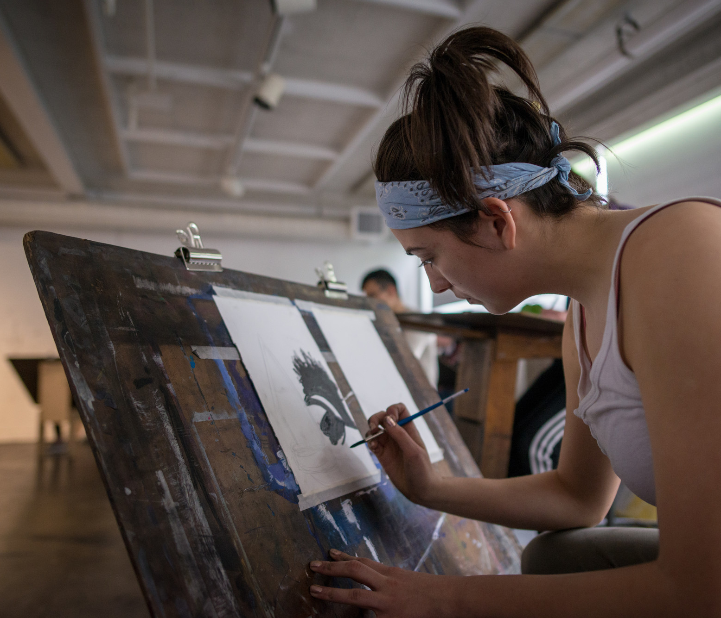
Access to these slides?

Slide 14
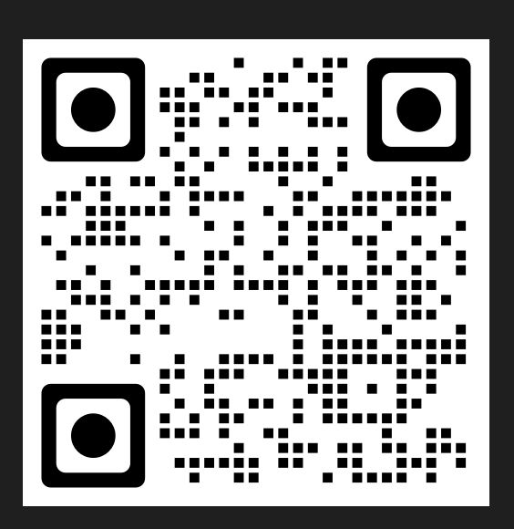
QR code to access:

Slide 15


Slide 16
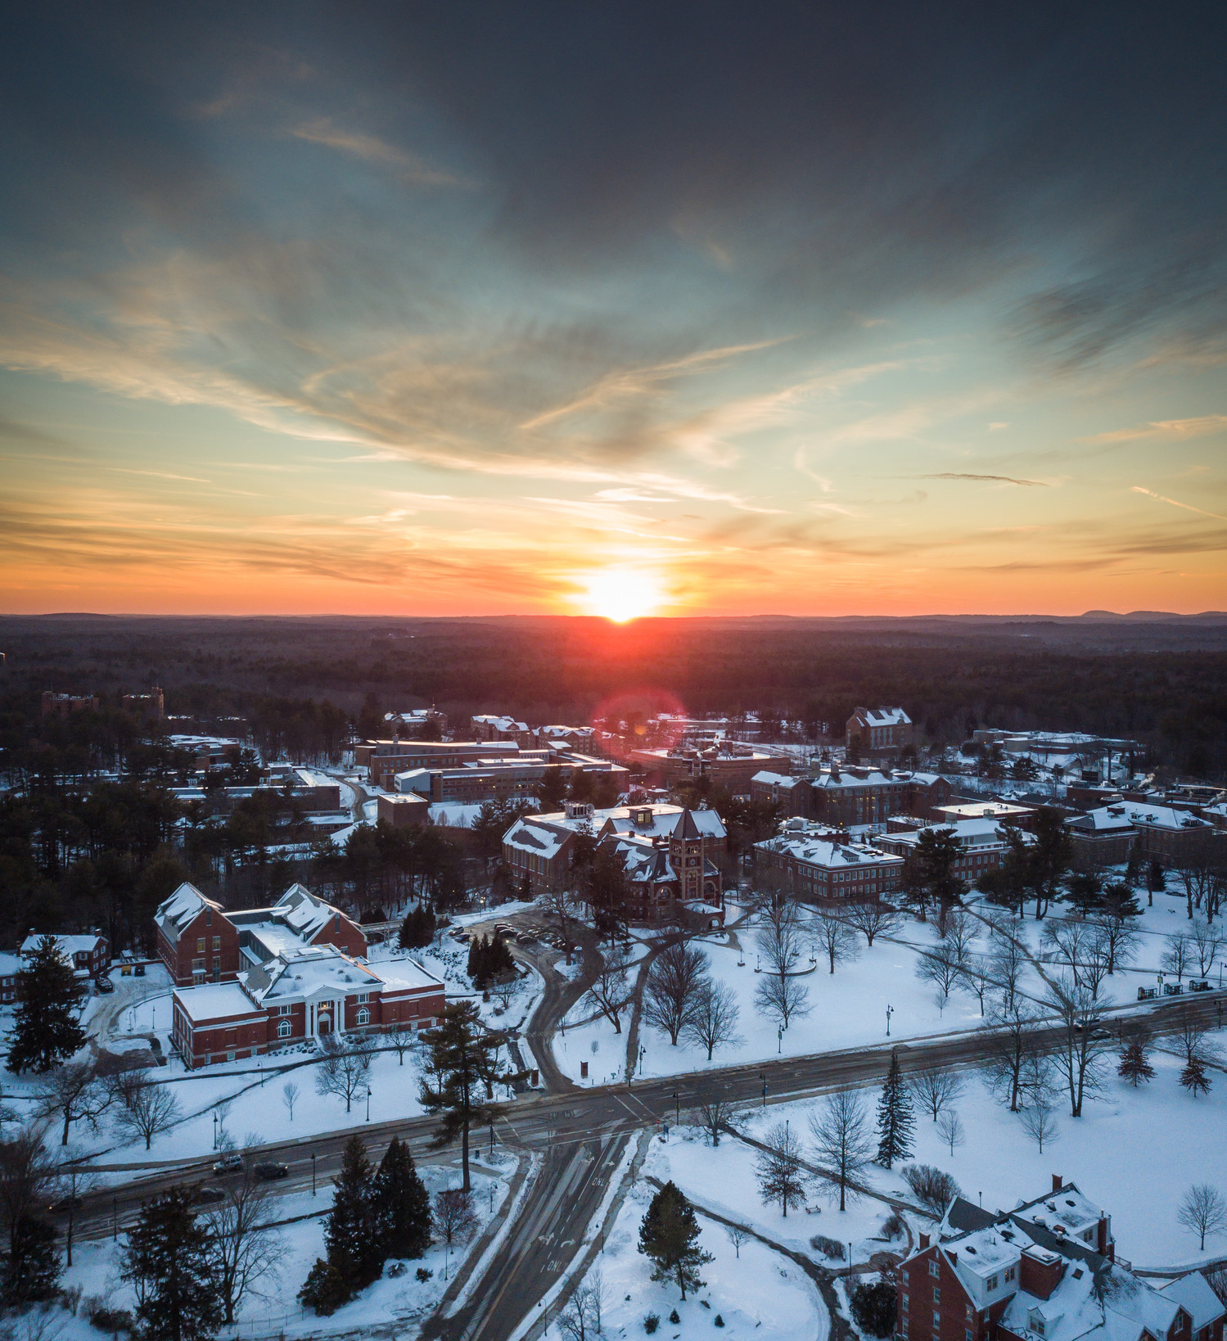
PP QR and email contact:
Liberal.arts@unh.edu
Uac.advisors@unh.edu

